Slide 1
Cloud Based Data Engineering
TF-IDF

Slide 2
Solve Problems With PySpark
TF-IDF

Slide 3
Term Frequency – Inverse Document Frequency
TF-IDF (term frequency-inverse document frequency) is a statistical measure that evaluates how relevant a word is to a document in a collection of documents.
Dome by multiplying two metrics:
how many times a word appears in a document
The inverse document frequency of the word across a set of documents.

Slide 4
Applications of TF-IDF
Information retrieval
TF-IDF was invented for document search and can be used to deliver results that are most relevant to what you’re searching for.
Keyword Extraction
Useful for extracting keywords from text
The highest scoring words of a document are the most relevant to that document

Slide 5
Terminology
t – term / word
d – document (set of words)
N – count of corpus
Corpus – the total document set
TF-IDF = Term Frequency (TF) * Inverse Document Frequency (IDF)

Slide 6

Terminology
$$TF\left(t,d\right)=\frac{count of t in d}{number of words in d}$$
$$DF\left(t\right)=occurrence of t in N documents$$
$$IDF\left(t\right)=\log\left(\frac{N}{DF\left(t\right)}\right)$$
$$TF−IDF\left(t,d\right)=TF\left(t,d\right)⋅\log\left(\frac{N}{DF\left(t\right)}\right)$$
TF-IDF = Term Frequency (TF) * Inverse Document Frequency (IDF)

Slide 7
Example
Document 1 It is going to rain today.
Document 2 Today I am not going outside.
Document 3 I am going to watch the season premiere.
Step 1: Counts
Word | Count
going | 3
to | 2
today | 2
i | 2
am | 2
it | 1
is | 1
rain | 1

Slide 8
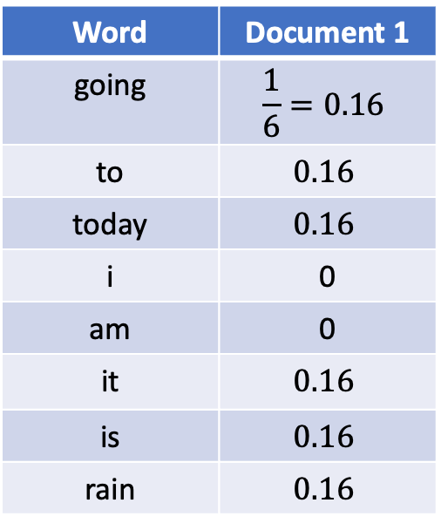
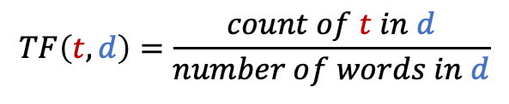
Example
Step 2: Find TF
$$TF\left(t,d\right)=\frac{count of t in d}{number of words in d}$$
Word | Document 1
going | $$\frac{1}{6}=0.16$$
to | $$0.16$$
today | $$0.16$$
i | 0
am | 0
it | $$0.16$$
is | $$0.16$$
rain | $$0.16$$

Slide 9
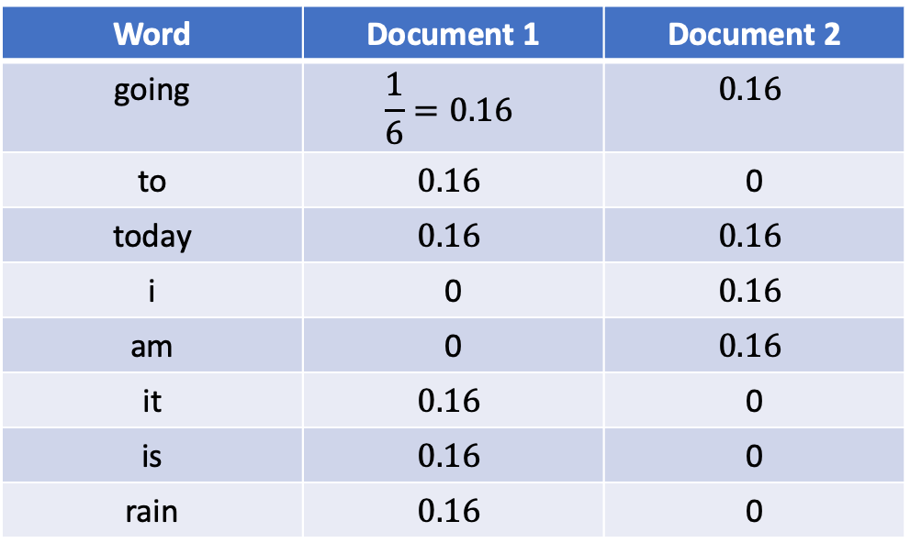
Example
Step 2: Find TF
$$TF\left(t,d\right)=\frac{count of t in d}{number of words in d}$$
Word | Document 1 | Document 2
going | $$\frac{1}{6}=0.16$$ | $$0.16$$
to | $$0.16$$ | 0
today | $$0.16$$ | $$0.16$$
i | 0 | $$0.16$$
am | 0 | $$0.16$$
it | $$0.16$$ | 0
is | $$0.16$$ | 0
rain | $$0.16$$ | 0

Slide 10
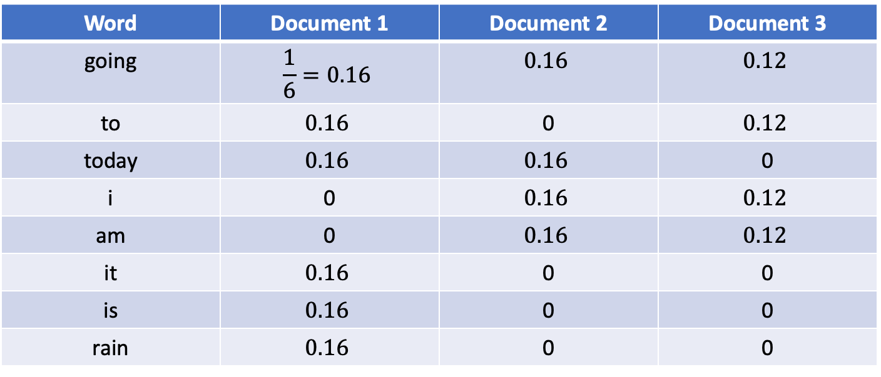
Example
Step 2: Find TF
$$TF\left(t,d\right)=\frac{count of t in d}{number of words in d}$$
Word | Document 1 | Document 2 | Document 3
going | $$\frac{1}{6}=0.16$$ | $$0.16$$ | $$0.12$$
to | $$0.16$$ | 0 | $$0.12$$
today | $$0.16$$ | $$0.16$$ | 0
i | 0 | $$0.16$$ | $$0.12$$
am | 0 | $$0.16$$ | $$0.12$$
it | $$0.16$$ | 0 | 0
is | $$0.16$$ | 0 | 0
rain | $$0.16$$ | 0 | 0

Slide 11
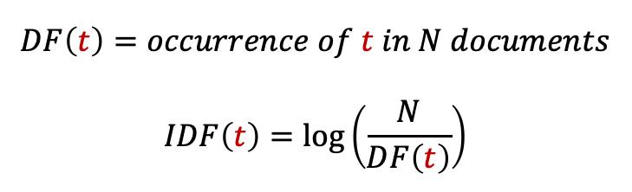
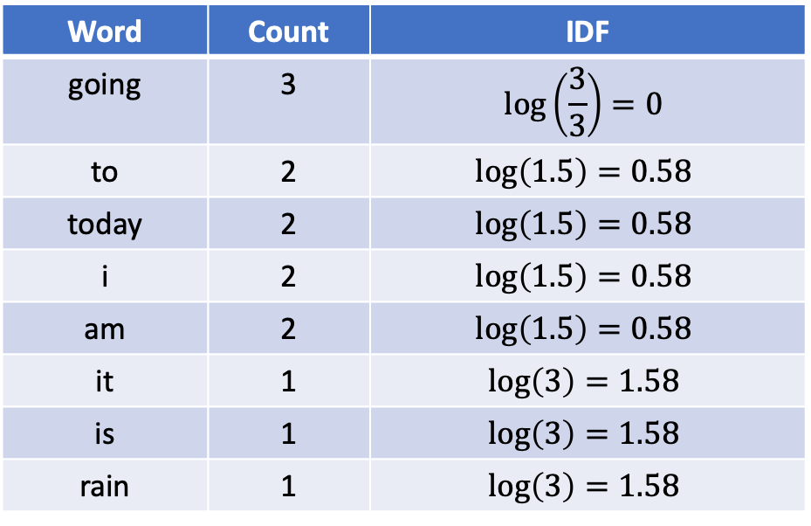
Example
Step 3: Find IDF
$$DF\left(t\right)=occurrence of t in N documents$$
$$IDF\left(t\right)=\log\left(\frac{N}{DF\left(t\right)}\right)$$
Word | Count | IDF
going | 3 | $$\log\left(\frac{3}{3}\right)=0$$
to | 2 | $$\log\left(1.5\right)=0.58$$
today | 2 | $$\log\left(1.5\right)=0.58$$
i | 2 | $$\log\left(1.5\right)=0.58$$
am | 2 | $$\log\left(1.5\right)=0.58$$
it | 1 | $$\log\left(3\right)=1.58$$
is | 1 | $$\log\left(3\right)=1.58$$
rain | 1 | $$\log\left(3\right)=1.58$$

Slide 12
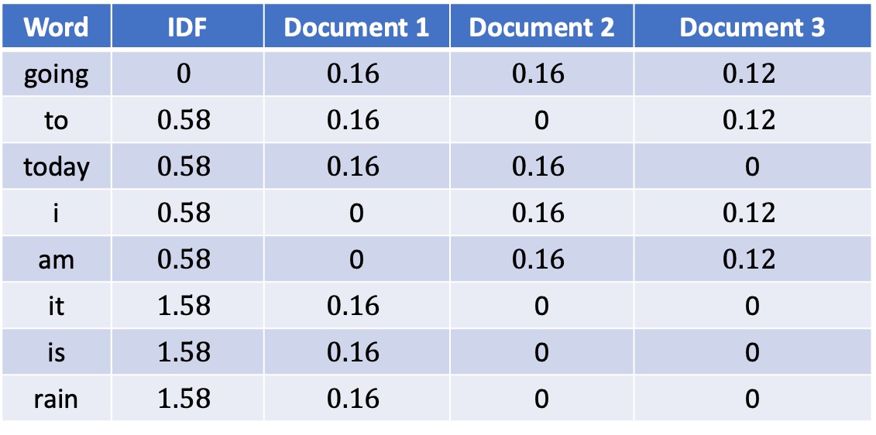
Example
Step 4: Find TF-IDF
Word | IDF | Document 1 | Document 2 | Document 3
going | $$0$$ | $$0.16$$ | $$0.16$$ | $$0.12$$
to | $$0.58$$ | $$0.16$$ | 0 | $$0.12$$
today | $$0.58$$ | $$0.16$$ | $$0.16$$ | 0
i | $$0.58$$ | 0 | $$0.16$$ | $$0.12$$
am | $$0.58$$ | 0 | $$0.16$$ | $$0.12$$
it | $$1.58$$ | $$0.16$$ | 0 | 0
is | $$1.58$$ | $$0.16$$ | 0 | 0
rain | $$1.58$$ | $$0.16$$ | 0 | 0

Slide 13
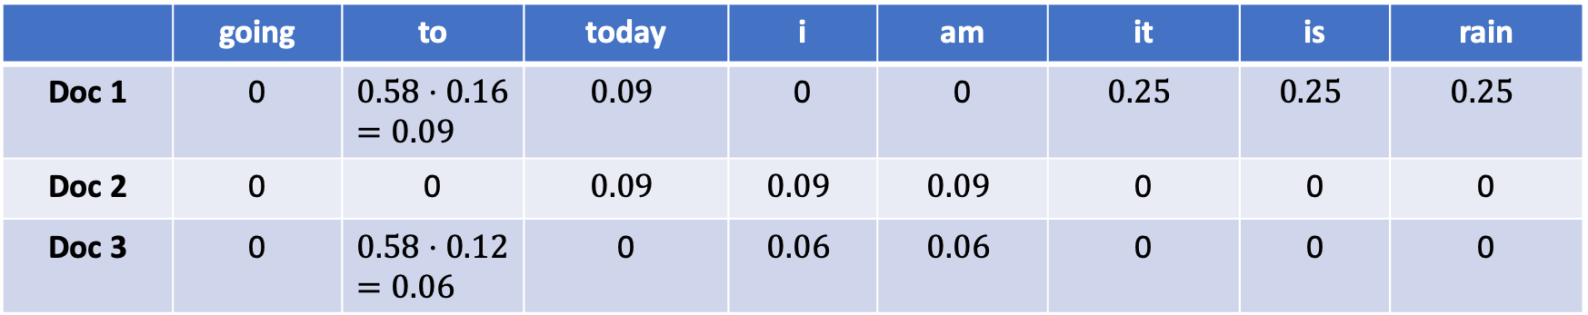
Example
Step 4: Find TF-IDF
“it”, “is”, “rain” important for doc1 but not for docs 2 and 3.
Docs 1 and 2 talks about today
 | going | to | today | i | am | it | is | rain
Doc 1 | 0 | $$0.58⋅0.16=0.09$$ | $$0.09$$ | 0 | 0 | $$0.25$$ | $$0.25$$ | $$0.25$$
Doc 2 | 0 | 0 | $$0.09$$ | $$0.09$$ | $$0.09$$ | 0 | 0 | 0
Doc 3 | 0 | $$0.58⋅0.12=0.06$$ | 0 | $$0.06$$ | $$0.06$$ | 0 | 0 | 0

Slide 14
TF-IDF Distributed Approach
Task 1: Word Frequency in Doc
Mapper
  Input: (docname, contents)
  Output: ((word, docname), 1)
Reducer
  Sums counts for word in document
  Outputs ((word, docname), n)

Slide 15
TF-IDF Distributed Approach
Task 2: Word Counts For Docs
Mapper
  Input: ((word, docname), n)
  Output: (docname, (word, n))
Reducer
  Sums frequency of individual n’s in same doc
  Feeds original data through
  Outputs ((word, docname), (n, N))

Slide 16
TF-IDF Distributed Approach
Task 3: Word Frequency In Corpus
Mapper
  Input: ((word, docname), (n, N))
  Output: (word, (docname, n, N, 1))
Reducer
  Sums counts for word in corpus
  Outputs ((word, docname), (n, N, m))

Slide 17
TF-IDF Distributed Approach
Task 4: Calculate TF-IDF
Mapper
  Input: ((word, docname), (n, N, m))
  Output ((word, docname), TF*IDF)
Reducer
  Just the identity function

